Slide 1
Customer Segmentation
Wonderful Wines of the World
Catarina Moreira nº20201034
Luísa Barral nº20201045
Maria Madalena Valério nº20200657
Yu Song nº20200572
NOVA Information Management School – Business Cases with Data Science (Spring 2020/2021)

Slide 2
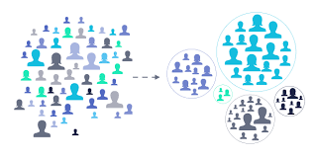
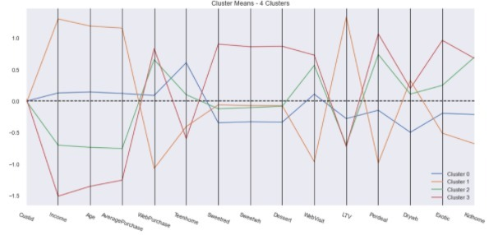
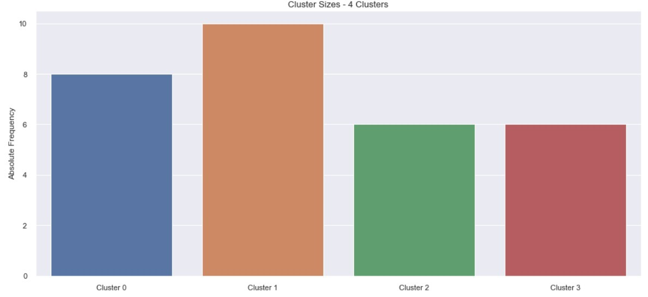
Clustering Algorithms

Slide 3
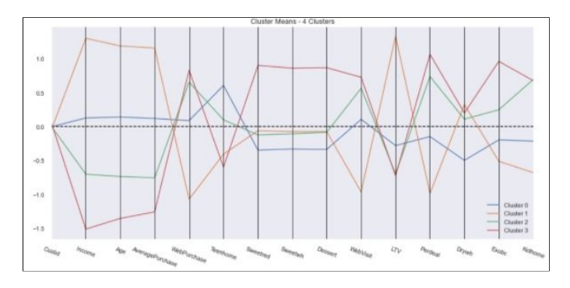
Demographic & Behavioral variables
1. Evaluate the importance of all the variables
2. Create a dataframe with the most important variables
3. Clustering algorithms for identifying general-shaped groups K-means + Hierarchical Clustering

Slide 4
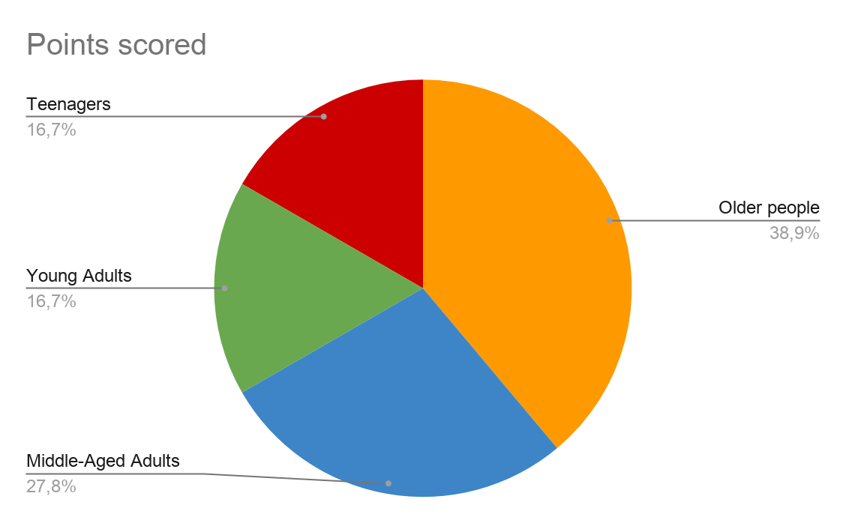
Wonderful Wines of the World’s Customers
Older people: >=60 years old with high income and no kids at home.
Middle-aged Adults: 40-59 years old, with a decent income with older kids.
Young Adults: 27-39 years old, with a low income and with young kids at home.
Teenagers: 19-26 years years old customers with very low income.
------------------

Slide 5
Marketing Suggestions
Cluster 0: Middle-aged Adults
With decent income and older children, they purchased lower quantity of most wine. they are getting used to the concept of shopping online, and not quite sensitive to discounts.
Strategy:
Pay more attention to our middle-age clients and cultivate them as our high value clients in the future. Posting more ads with various choices and lead them to shop online more frequently

Slide 6
Marketing Suggestions
Cluster 1: Older people
Older clients with highest income but not sensitive to discounts and normally less shop online. They have the highest percentage of dry white wine consumption and average of other kinds, not big fans of exotic wines.
Strategy:
Keep maintaining our most lifetime value clients through supporting various good quality wine and encouraging them to visit our web to purchase online.

Slide 7
Marketing Suggestions
Cluster 2: Young Adults
Young adults with lower income with teenager at home, purchasing more during discount on the internet with lower price
Strategy:
Every month or so provide them with discounts to be used online in a selected range of dry and exotic wines as well as notifications of promotions.

Slide 8
Marketing Suggestions
Cluster 3: Teenagers
Teenagers with lowest income, purchasing more during discount on the internet with lower average price and are more likely to buy all kinds of wine especially exotic wines.
Strategy:
These clients spend more time visiting our webs, we should post more ads via emails with various kinds of wine and attractive discounts.

Slide 9
Summarize
Older People | Middle-Aged Adults | Young Adults | Teenagers
Our most important customers | Important customers that we should paid more attention | Represents a small group of our customers | These customers enjoy all types of wines
Preference in dry wines | They don’t have any real preference in wine | Customers that appreciate dry and exotic wines | Due to their low income they take advantage of the promotions
They purchase the wine at the stores, or by telephone | They purchase wine online as well at stores | They purchase wine mostly online | They purchase wine online the most

Slide 10
THANK YOU !
Catarina Moreira nº20201034
Luisa Barral nº20201045
Maria Madalena Valério nº20200657
Yu Song nº20200572

